Slide 1
What Determines Price?
Part Three

Slide 2
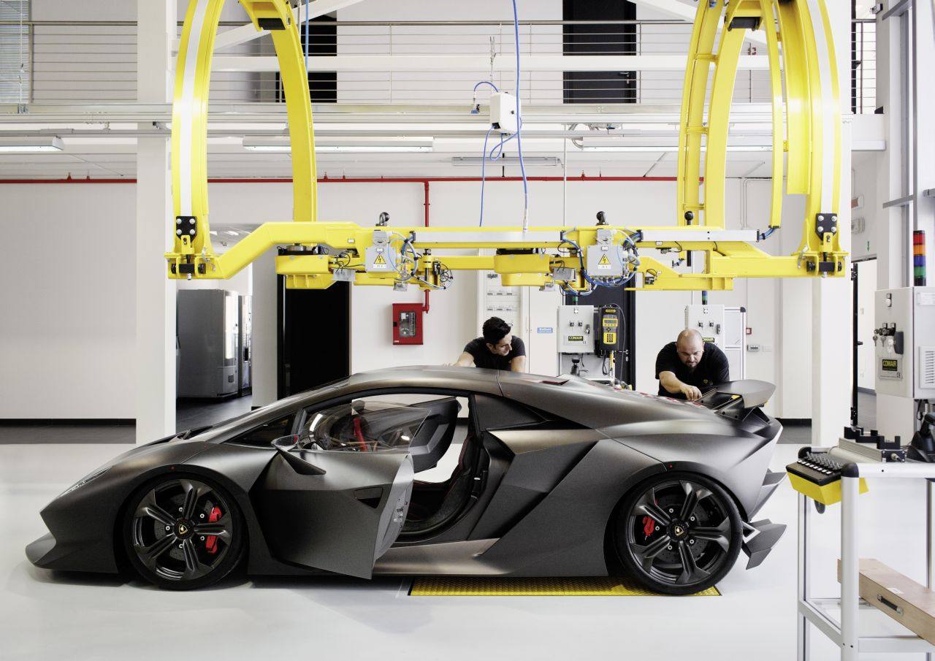
Production and Marketing Costs
Prices is influenced by:
The Nature of the Market
Consumer Demand of Product
Production and Marketing Costs
Consideration of Channel Members

Slide 3
Cost With an Effect on Price
Cost that have a direct effect in price include the following:
Cost of labour
Raw materials
Processed materials
Capital requirements
Transportation
Marketing Administration
It is common practice to add the above elements to create a total product cost and than add a fair profit margin
The selling price is than sold to distributors with all things above considered
It is important to account for the addition of a retail price when creating your selling cost

Slide 4
Unpredictable Rise in Costs
As a organizations costs rise, pricing becomes more complicated
If projected costs rise gradually, it is possible to build a pricing strategy for the upcoming years, if prices are not consistent however companies have to face difficult decisions
Companies have two options:
Raise prices in order to cover costs
Absorb rising costs in hope they will return to normal and lower profit margins

Slide 5
The Cereal Example
In 2004, wheat prices increased by 20%, rice and soy beans increased by 80%, and oil seed by 55%
Prices of cereal increased by as much as 7% and left a decline in customers
In 2003, Cheerios raised its price by a small amount to cover its costs only to lose customers for nine straight months to cheaper budget brands

Slide 6
The Other Option
To avoid rising costs, companies offer look for options to lower them
Such options include:
Improving production efficiency (New machinery or Automation)
Using less expensive materials (Lower price ingredients or packaging)
Shrinking the size of a product (Smaller Cookies/Same Price)
Reloaction (Moving Plants from Canada to Mexico)

Slide 7
The Frito Lay Example
In Canada
Hostess Frito Lay implemented a cost reduction program that reduced the size of a bag of chips from 170 grams to 150 grams
The reduction in size was followed by a reduction in price which led to a big boost in sales within Canada
In the USA
Hostess Frito Lay reduced chip bag sizes by 7% with no corresponding drop in price
Hostess Frito Lay sells over 1.18 Billion Kilograms in chips a year
The 7% decrease in size will save the company US$154.7 Million a year

Slide 8
Industries With Lowering Costs
In some industries, it is actually possible for costs to lower allowing all prices to be lowered
Examples of such industries include
Computer Industry
Smartphone Industry
Television Industry
Digital Storage Industry

